Slide 1
PANCE 2 Analysis

Slide 2
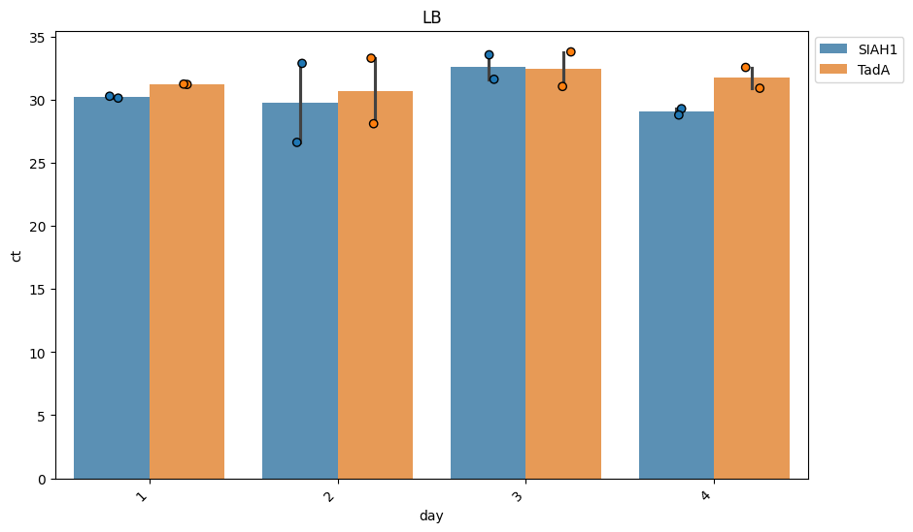
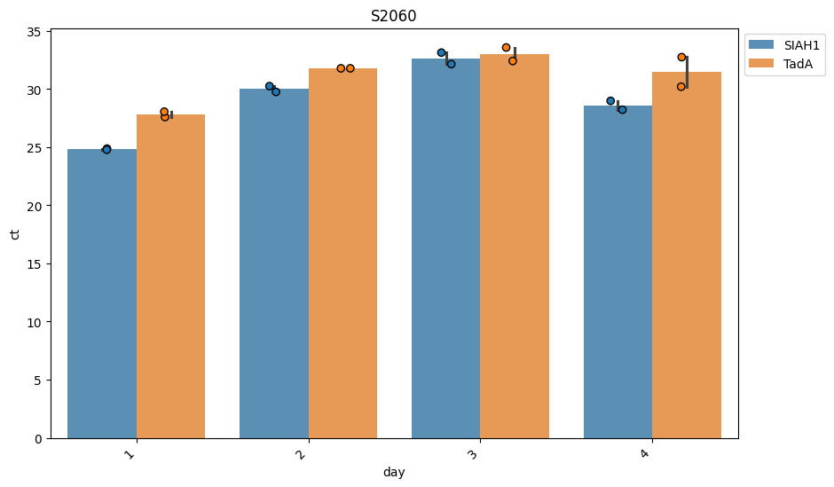
Controls
Initial phage titer seems to be very low

Slide 3
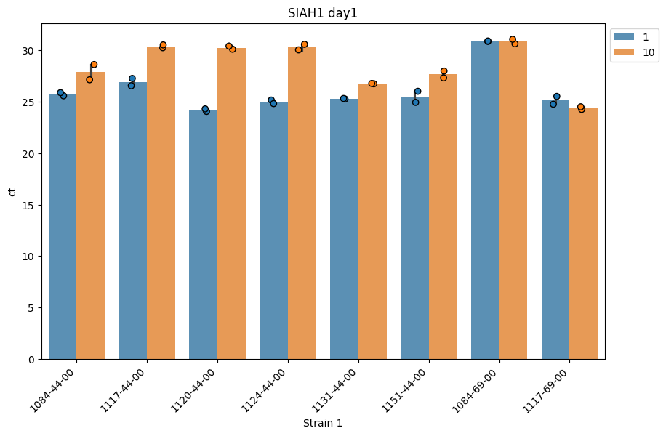
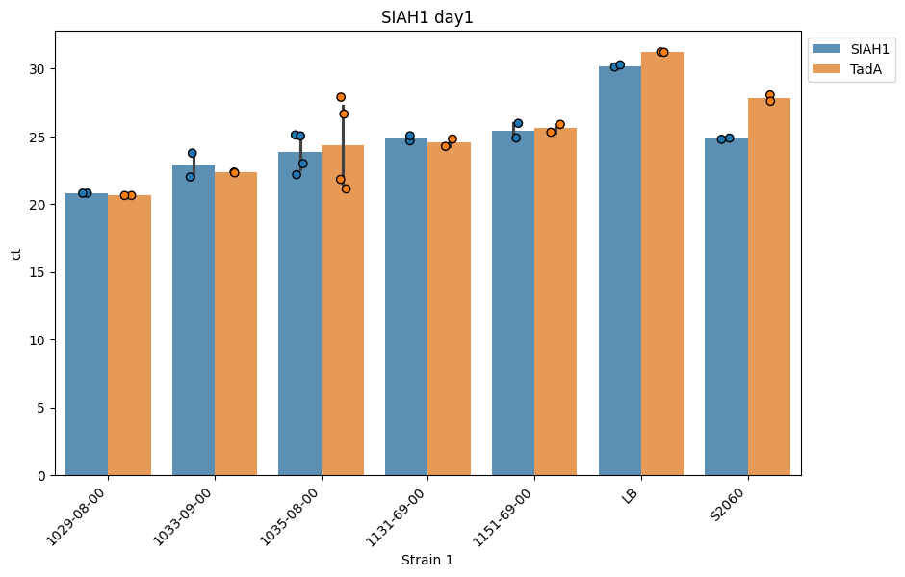
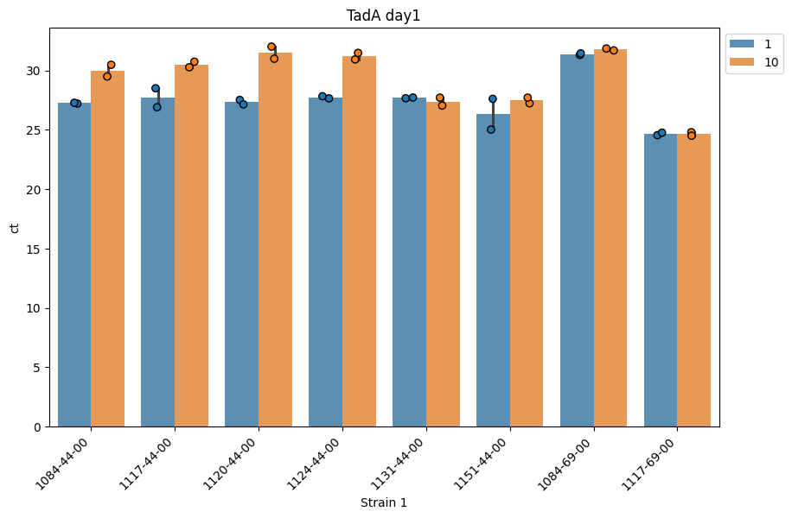
Day1
1084-69 looks dead already on day1
1117-44, 1120-44, 1124-44 got killed by adding 10um van
Other-wise no diff between siah and tada

Slide 4
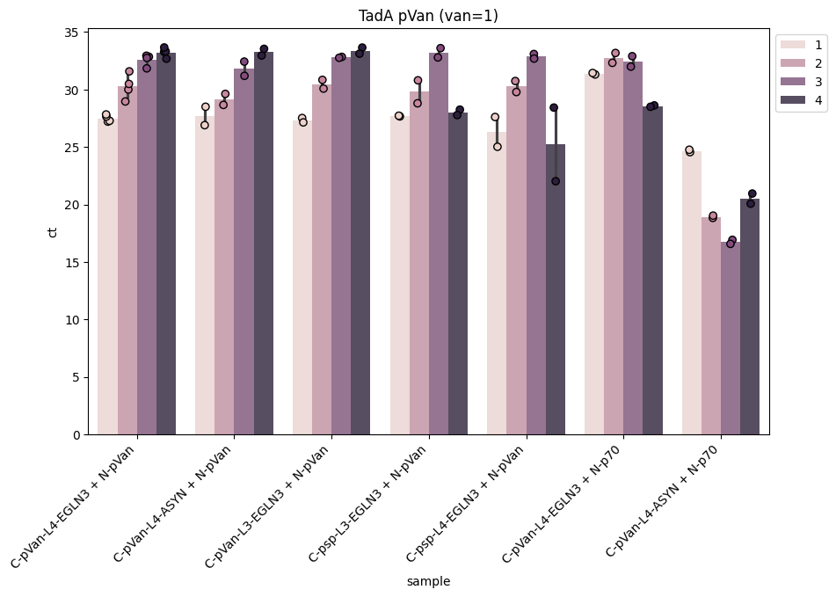
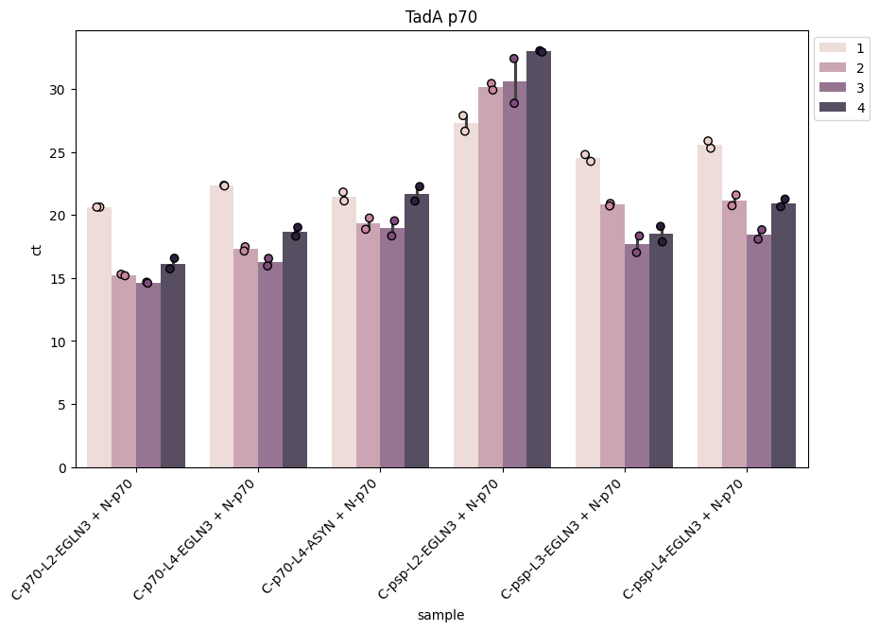
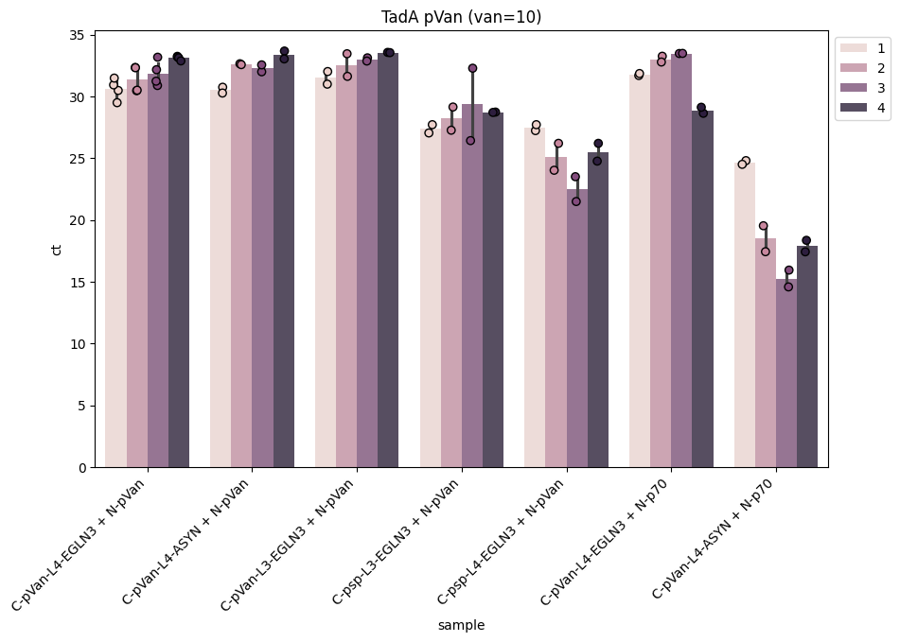
TadA propagation
TadA propagates on p70
TadA washes out on pVan+pVan
10ul activates propagation on psp+pVan
Day 4 looks weird

Slide 5
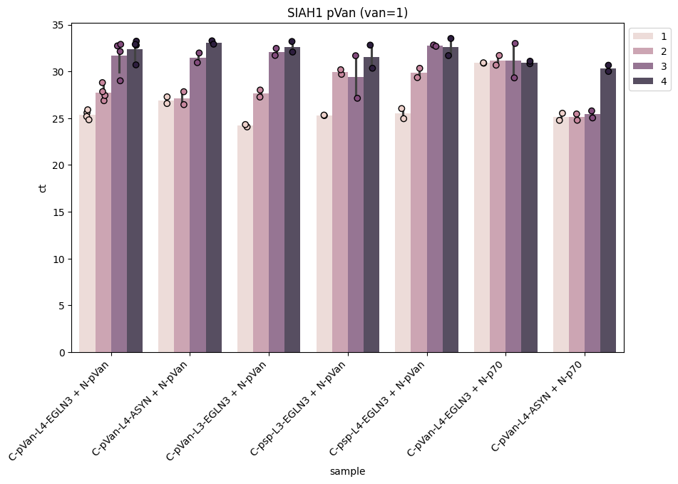
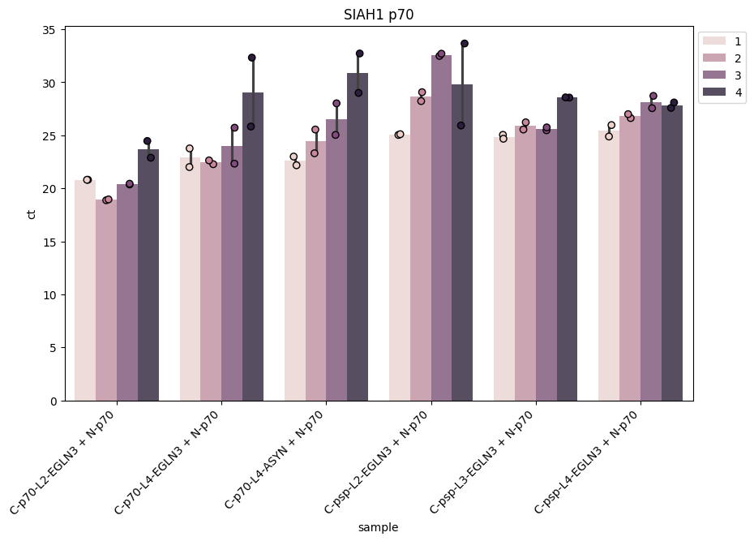
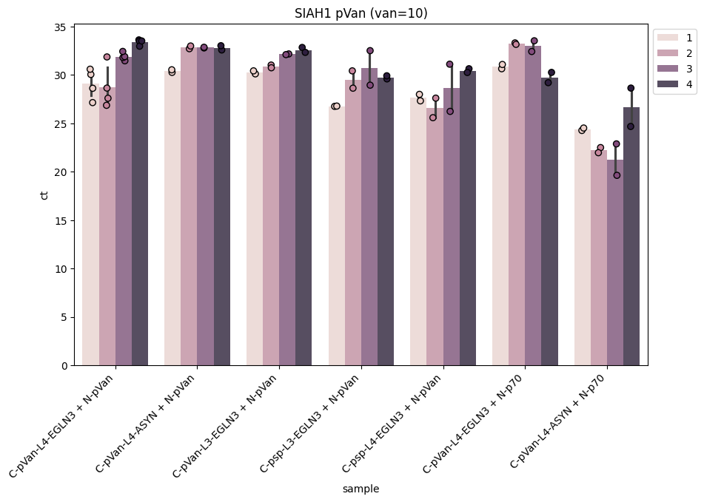
SIAH1 Propagation
SIAH1 propagates on p70 (ignore day4)

Slide 6
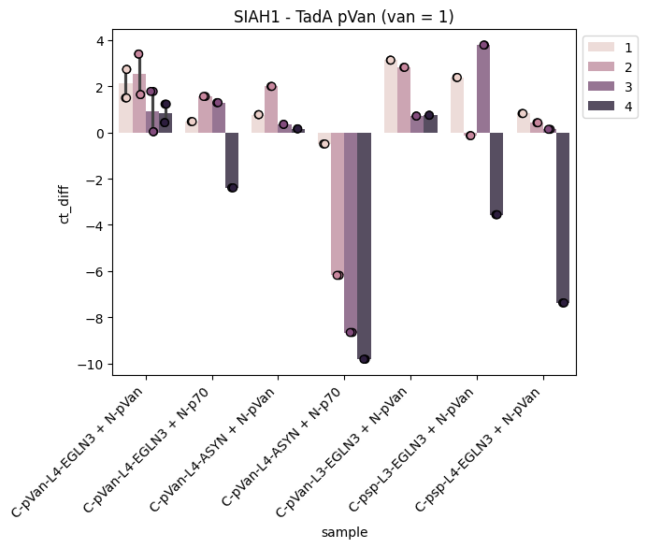
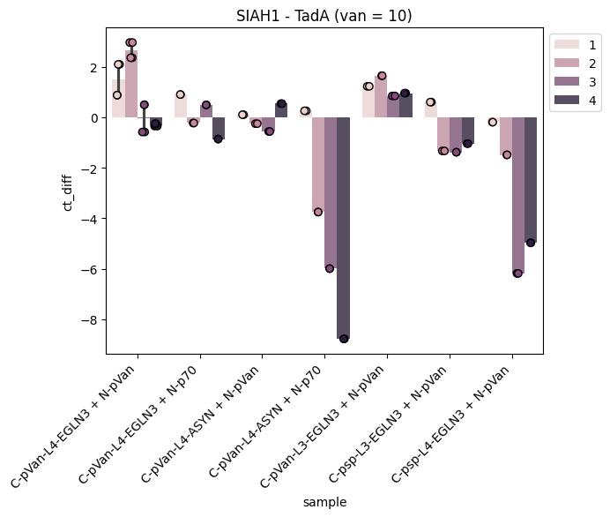
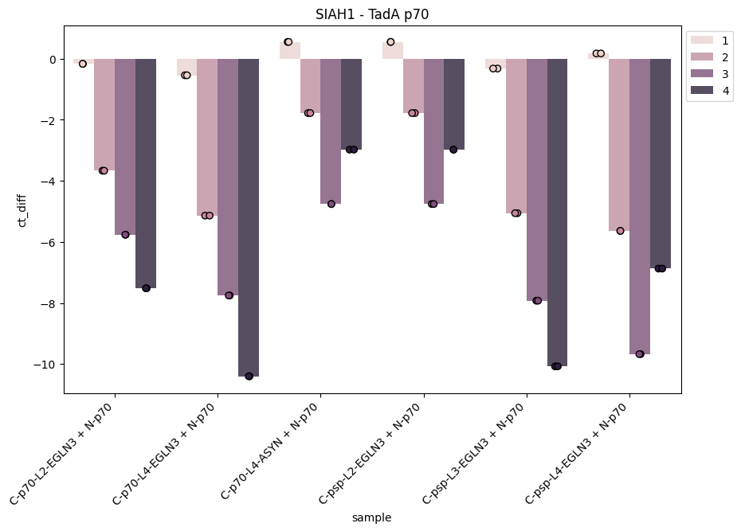
SIAH vs TadA
Number > 0 means that SIAH 1 is better than TadA
TadA seems better on p70 (let’s assume logic independent, due to faster phage?)
Diff is smaller on pVan -> is it because logic matters more or because nothing propagates there?

Slide 7
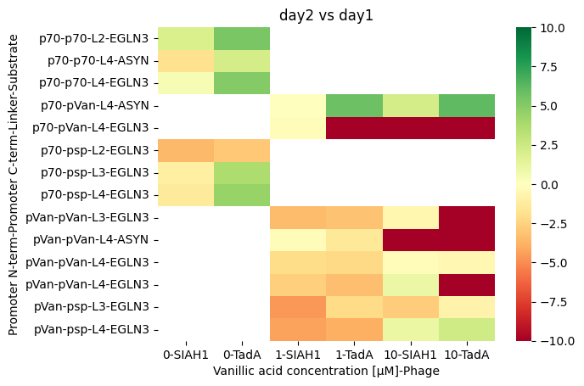
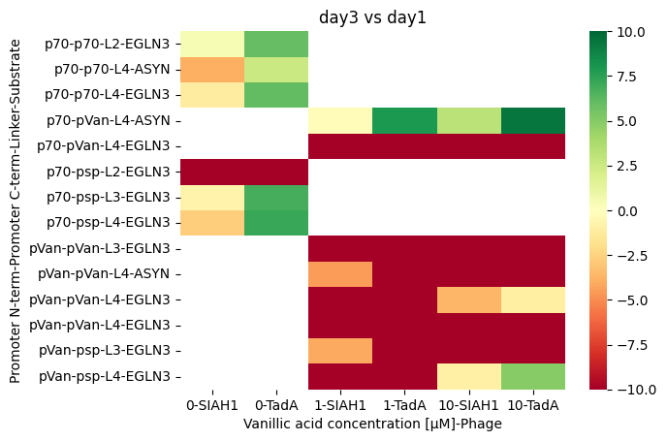
SIAH vs TadA
Phage conc. norm. to day1 (green == phage titer increased)
ct>32 is considered a washout (red)

